Slide 1
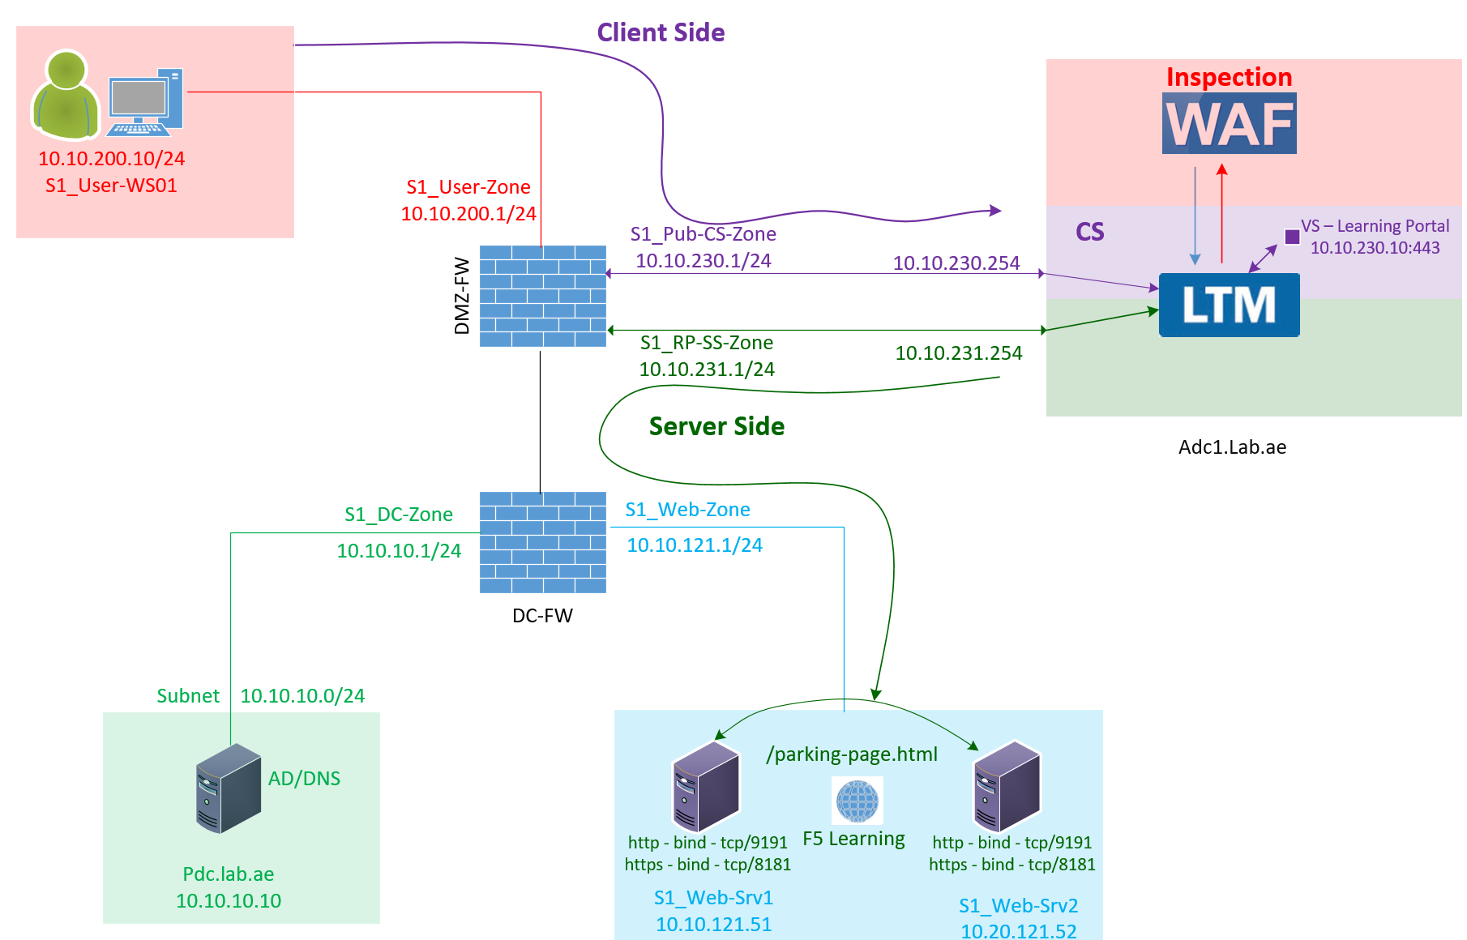

F5 LTM Learning with
Alexander S
Bonus Chapter 05 – Explore and configure the HTTP profile in F5 LTM

Slide 2
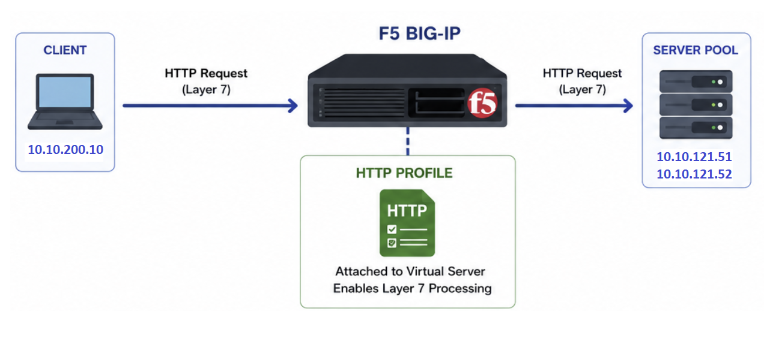
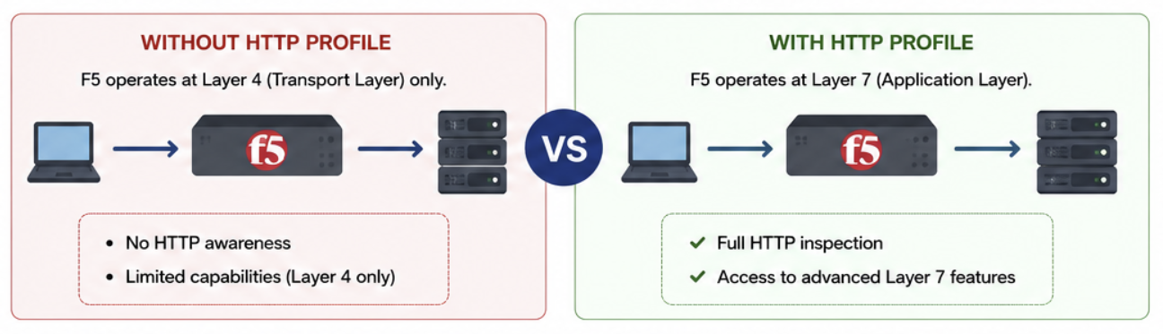
    HTTP Profile in F5 LTM for Full proxy Functionality
When an HTTP profile is attached to a Virtual Server, F5 starts processing traffic at Layer 7 instead of only Layer 4.
The HTTP profile enables Layer 7 processing of HTTP traffic on F5.

Slide 3
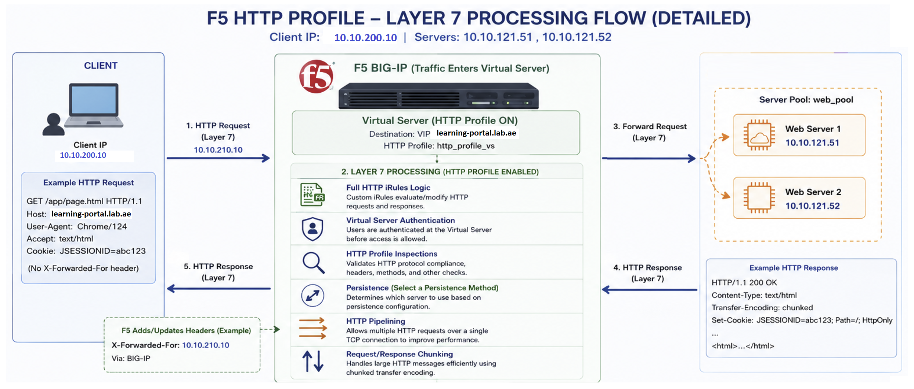
    HTTP Profile in F5 LTM
Must attach an HTTP profile to the Virtual Server
10.10.200.10
10.10.200.10

Slide 4
    HTTP Profile in F5 LTM (Full Proxy Required HTTP Profile)
In simple terms, without Layer 7 inspection, F5 cannot inspect or secure the traffic.
If you want F5 to function as a full reverse proxy, you must attach an HTTP profile along with the required supporting profiles.

Slide 5
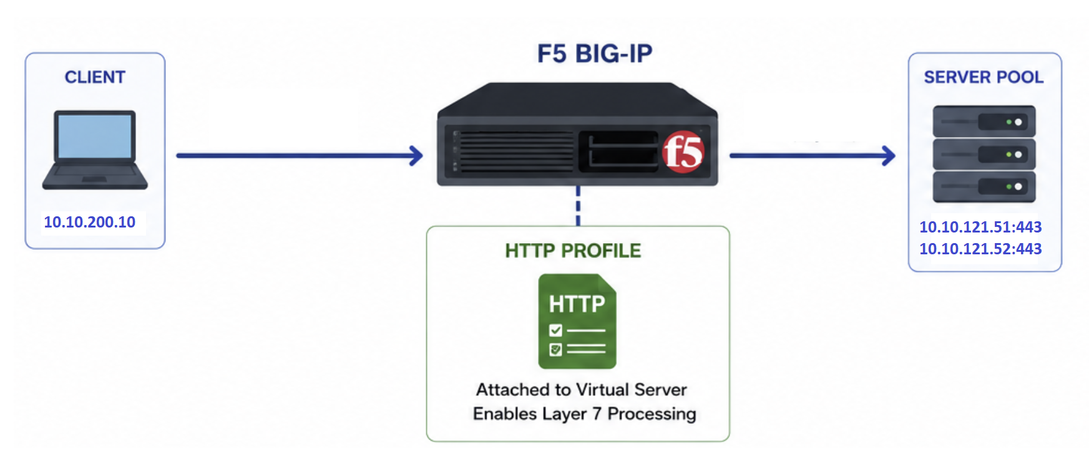
    HTTP Profile in F5 LTM (Client-SSL & Server-SSL profiles)
    To Decrypt & Inspect the http traffic
Assume the backend web server traffic is encrypted using TLS.
F5 is load balancing this traffic using an HTTPS Virtual Server.
An HTTP profile is attached to this Virtual Server.
Will F5 inspect this traffic without Client SSL and Server SSL profiles?

Slide 6
    HTTP Profile in F5 LTM (Client-SSL & Server-SSL profiles)
    To Decrypt & Inspect the http traffic
The answer is NO.
When the traffic is encrypted, F5 cannot decrypt and inspect the Virtual Server traffic without Client SSL and Server SSL profiles.
In this case, F5 works as a Layer 4 transparent proxy.
It simply load balances and forwards the traffic to the backend servers without performing Layer 7 inspection.

Slide 7
    HTTP Profile in F5 LTM (Client-SSL & Server-SSL profiles)
    To Decrypt & Inspect the http traffic
F5 cannot inspect encrypted traffic unless it decrypts it.
A Client SSL profile is required to terminate and decrypt the client-side TLS traffic.
Once the traffic is decrypted, the HTTP profile can process the traffic at Layer 7.
A Server SSL profile is required for F5 to re-encrypt and forward the traffic to the backend server.

Slide 8
    HTTP Profile in F5 LTM (Client-SSL & Server-SSL profiles)
    To Decrypt & Inspect the http traffic
An HTTP profile alone cannot inspect encrypted HTTP traffic.
To inspect and process encrypted traffic, you must attach both Client SSL and Server SSL profiles.

Slide 9
    Create a custom HTTP Profile in F5
Let us create a custom HTTP profile using F5-recommended settings.
Name the profile as Generic_HTTP_Profile.

Slide 10
    Difference between Reverse Proxy & Forward proxy
🚀 F5 LTM Learning Series – Chapter 03 – The need for a Reverse Proxy, focusing on LB and security
https://www.youtube.com/watch?v=WPHidqpQrz4

Slide 11
    HTTP Profile in F5 LTM (Insert X-Forwarded-For feature)
    Why do we need this feature?
F5 BIG-IP operates as a full proxy
Client (10.10.200.10) connects to F5 virtual server IP (10.10.230.10) to access the service.
The client connection terminates on the client-side virtual server of F5.
F5 inspects the HTTP request, and if the traffic is legitimate, it creates a new connection to the backend server.
This new connection uses the F5 self IP (server-side VLAN - 10.10.231.254) as the source IP.
As a Result - The web server sees the request coming from the F5 IP, not from the actual client IP.

Slide 12
    HTTP Profile in F5 LTM (Insert X-Forwarded-For feature)
When it is Problem?
When it is Problem?
Many applications require the original client IP for:
Logging
Security controls
User tracking

Slide 13
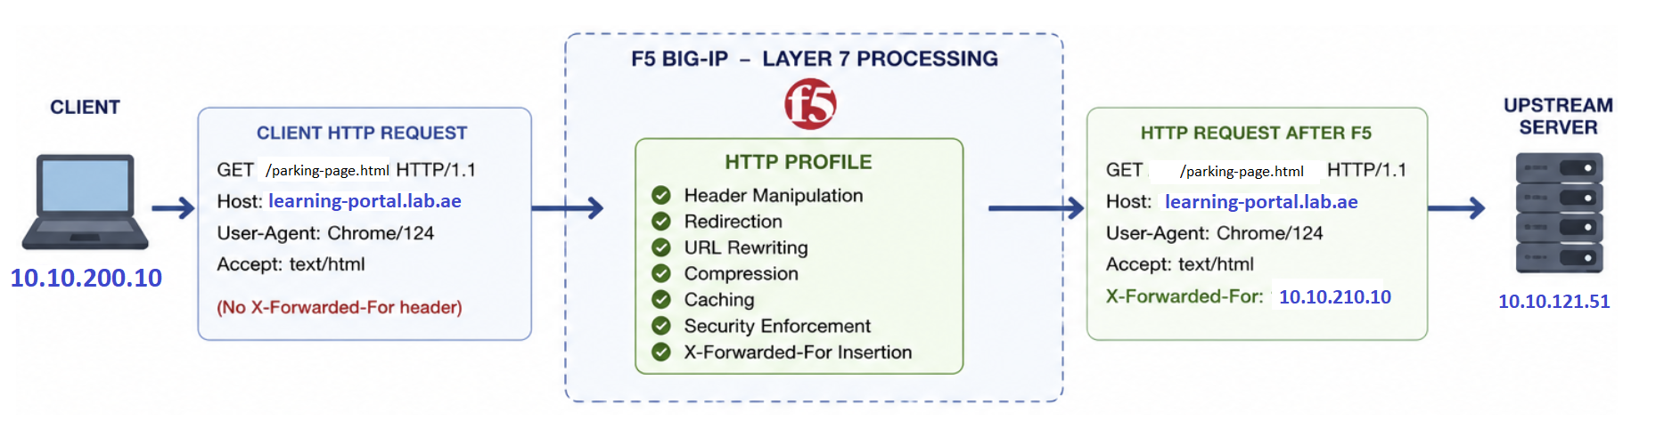
    HTTP Profile in F5 LTM (Insert X-Forwarded-For feature)
How to solve this problem?
Enabling Insert X-Forwarded-For in HTTP profile
10.10.200.10

Slide 14
Chapter 07 – HTTP Profile
(Hardening)
When you use the default HTTP profile settings on F5, it exposes its identity in HTTP responses.
This reveals information to the end user that a reverse proxy is in use.
To prevent this, we can remove the Server header (BIG-IP) from the response.
This hardening
  To Prevents information leakage
  Reduces attack surface
  Avoids giving attackers clues about infrastructure
Generic_HTTP_Profile
Generic_HTTP_Profile

Slide 15
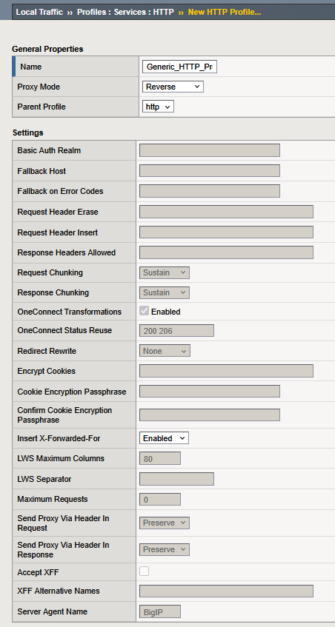
Chapter 07 – HTTP Profile
(Hardening)
When you use the default HTTP profile settings on F5, it exposes its identity in HTTP responses.
This reveals information to the end user that a reverse proxy is in use.
To prevent this, we can remove the Server header (BIG-IP) from the response.
This hardening
  To Prevents information leakage
  Reduces attack surface
  Avoids giving attackers clues about infrastructure

Slide 16
Bonus Chapter 05 – Explore and configure the HTTP profile in F5 LTM
You can attach this profile when configuring the Virtual Server.
I hope this video helped you to understand and configure the HTTP profile in F5 LTM.
This brings us to the end of Bonus Chapter 5.
Thank you for watching.
Generic_HTTP_Profile
Generic_HTTP_Profile

